Slide 1
COM6002 Big Data Management
Introduction to big data management

Slide 2
Big Data
What is big data?
Big data primarily refers to data sets that are too large or complex to be dealt with by traditional data-processing application software.
https://en.wikipedia.org/wiki/Big_data
When some people talk about Big Data, they simply mean the data they are working on
And the data is not large in volume

Slide 3
Characteristics of Big Data
4 V’s of Big Data
Volume
Variety
Veracity
Velocity

Slide 4
Volume: Too much data to handle
Example task:
Study the social sentiment about bitcoin since launch (2009)
Data source: Twitter data archive
https://archive.org/search.php?query=collection%3Atwitterstream&sort=-publicdate
5M text messages per day. Around 2GB per day. (Twitter stats: around 500M messages per day)

Slide 5

Variety: Multiple types / formats
What kind of data can you find on Twitter?
Multi-lingual text
Images
Videos
…
A sample tweet (Twitter message)

Slide 6
Graph data
Alice is following Elon, Bob is following Elon, …
Can be represented in a graph
Graph analysis:
Who is a KOL (Key Opinion Leader)?
Elon
Alice
Bob
Cathy
Doris

Slide 7
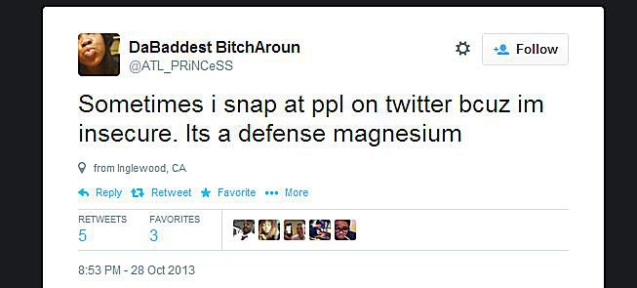
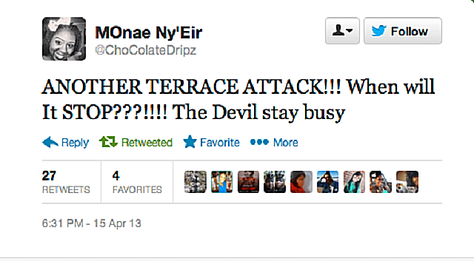
Veracity: data quality
Is your data always correct?
Mechanism?
Terrorist?

Slide 8
GIGO - Garbage in, garbage out
Data quality is very important!
Other data quality concerns
Missing data
Duplicated data
Ambiguous data
Inconsistency
“There is a bird in a cage that can talk.”
Who can talk?

Slide 9
Velocity: speed of data
Big Data is often real-time data
Data is generated continuously
The data source does not always keep all the data for you to download later
Example scenario: let’s keep information about bitcoin on exchange platforms
Data source:
https://www.binance.com/en/futures/BTCUSDT
What data should we keep?
The trade queue every update?

Slide 10
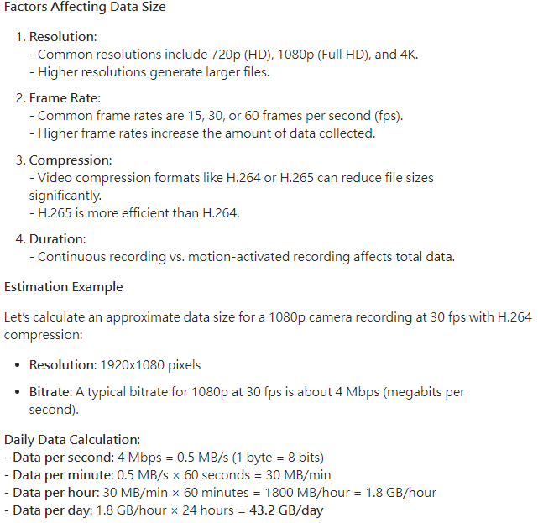
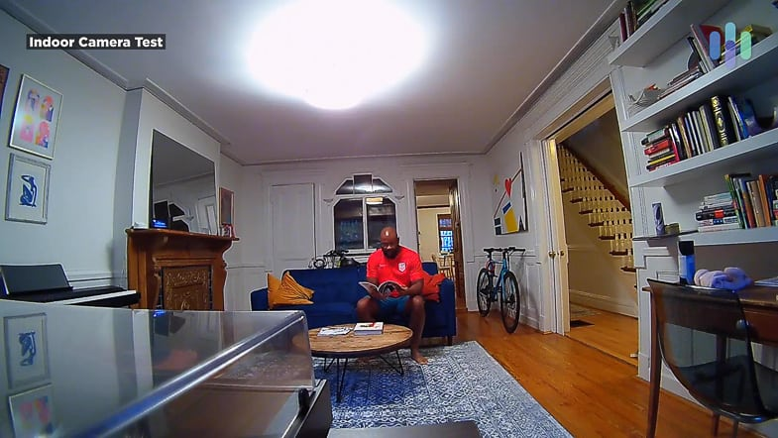
Another example scenario
Home security camera app
Will you keep the video data?
https://www.quora.com/How-much-data-of-CCTV-camera-is-collected-one-day-in-GBs-and-where-it-store-its-heavy-data

Slide 11
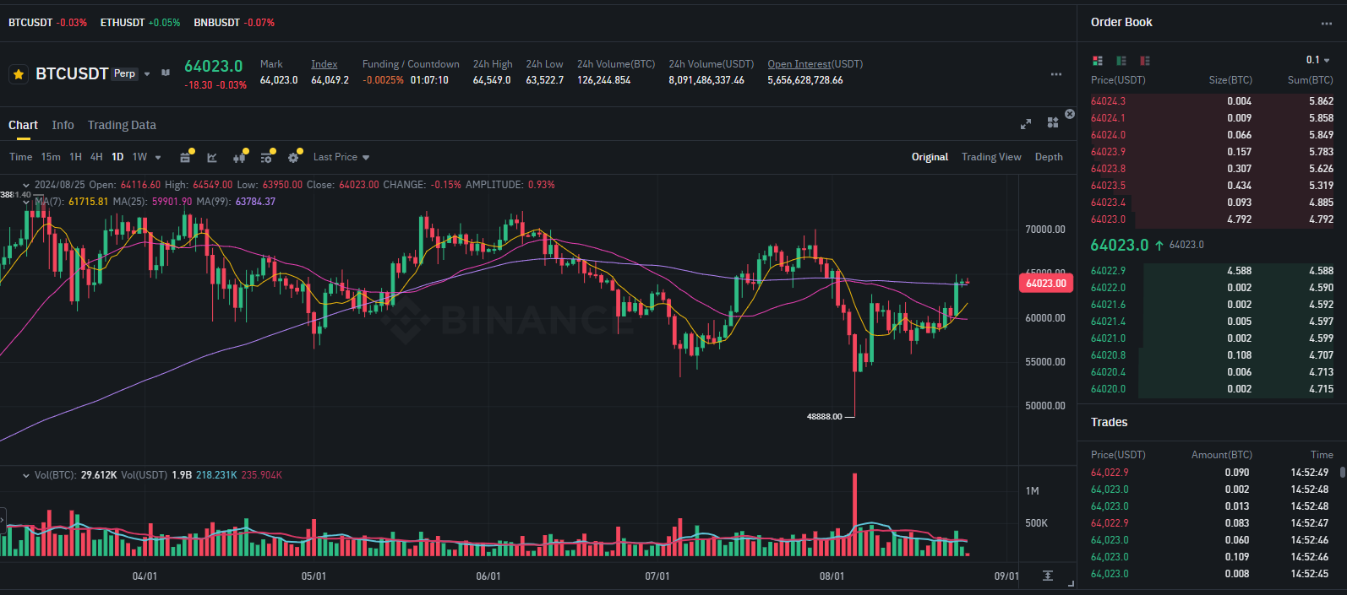
What data should we keep?

Slide 12
Streaming algorithms
What if the data generation speed is far more than our storage capability?
Streaming algorithms
https://en.wikipedia.org/wiki/Streaming_algorithm
Key design issues:
How to extract key summaries and what to keep?
Can we find the exact answers to queries?
If it is an approximation, how close will it be? Any bounds on the performance?

Slide 13
Example: Bloom filter
Note:
The details of this algorithm will NOT be asked in the exam
It just gives you a feeling about how a streaming algorithm works
Usage:
To check if a data item has appeared before
A bloom filter is simply an array of 0 or 1
Processing a data item
Hash it with multiple hash functions. Set the corresponding slots to 1
Data
 |  | 1 | 1 |  |  | 1

Slide 14
Example: Bloom filter
Query (is the data item seen before?):
Hash the query with the same set of hash functions, return true if all slots are 1
Properties:
There is no false negative
Bit array is space-efficient
Q: Is bloom filter better than a simple hash table?
Query
 |  | 1 |  | 0 |  | 1
False

Slide 15
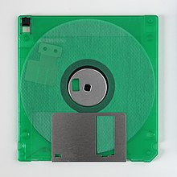
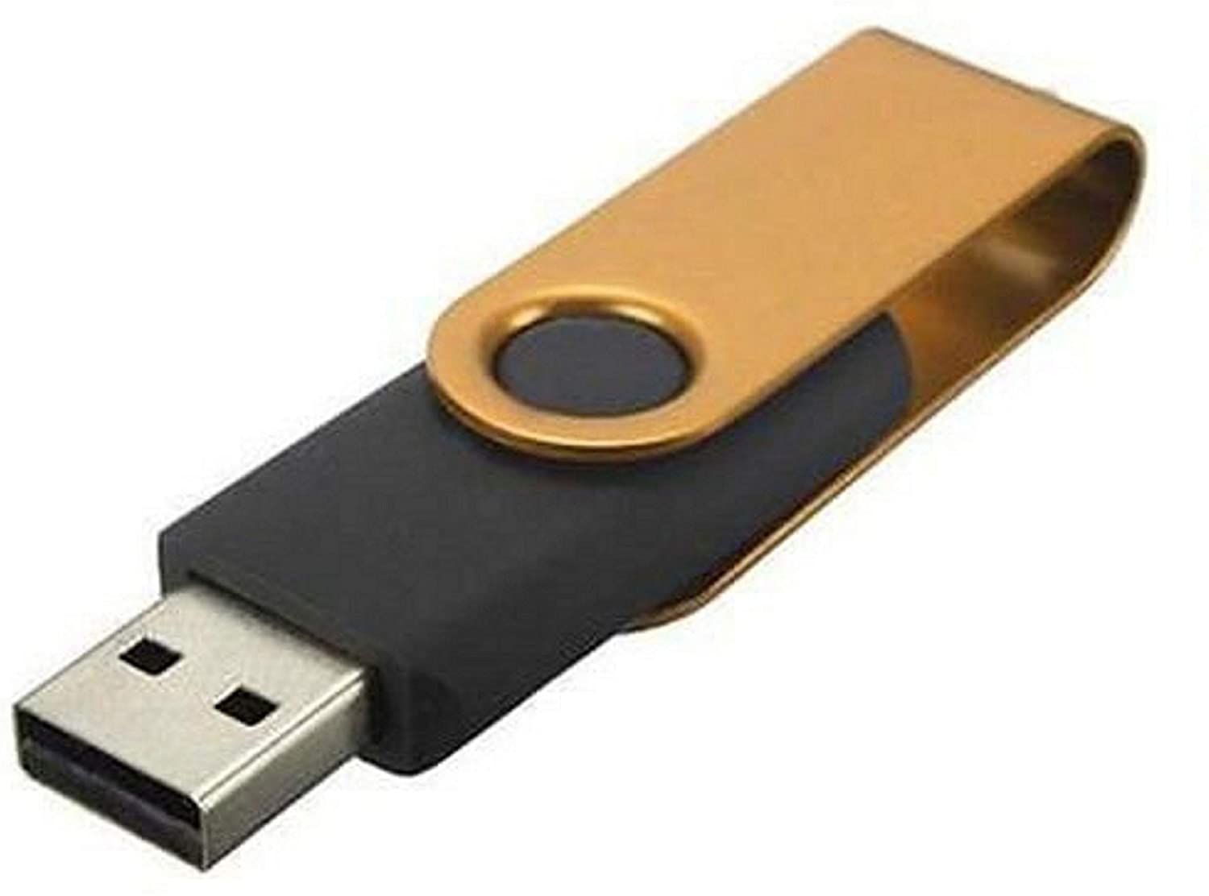


Why do we have Big Data?
Internet!
Many data sources are available to the public
Example:
Social network: Twitter
Finance: Cryptocurrency market data
Increased capability of machines, e.g., increased storage
We tend to store more data
256 GB
~ HKD $100
15 GB
Personal
Free
1.44MB
1990’s

Slide 16
The habit has changed!
All of us are generating more data
Personal: Photos / videos
Business: more online services

Slide 17
History of data management
Computer files
Baseline option for a digitalized copy of data
Relational DataBase Management System (RDBMS)
1970-now
Has a well-defined table structure
Many advantages over file storage, e.g., search efficiency, better backup and recovery
Main query language: SQL (Structured Query Language)

Slide 18
Example relational data
Date | Open | High | Low | Close | Volume
1/1 | 3.2 | 3.5 | 3.1 | 3.2 | 1.6M
2/1 | 3.2 | 3.3 | 2.9 | 3 | 1M
3/1 | 3 | 3.6 | 2.9 | 3.5 | 2M
4/1 | 3.5 | 3.9 | 3.1 | 3.6 | 2.3M

Slide 19
History of data management
NoSQL database
NoSQL stands for Not-only SQL
Data is not well structured as a table
There are different types of NoSQL databases
Graph database
Key-value store
Document store
Example: MongoDB is a document store

Slide 20
Example MongoDB data
Q: What happens if we put the data in a table?
Symbol: ETH
Date: 1/1
Close: 11.3
BTC Correlation: 0.77
Symbol: BTC
Date: 1/1
Open: 3.1
High: 3.3
Low: 2.9
Close: 3.1
Sentiment: 0.39
Basis: 0.0003
Whale transactions: 1056
Symbol: DOGE
Date: 1/1
Close: 0.000065
Twitter mention: 25,694

Slide 21
Which type of database should we use?
This is the main theme of this module!
More details about RDBMS vs NoSQL will be discussed after we learn more about RDBMS and NoSQL in the coming lectures
Actually, we need to consider other options like HDFS as well…
Pre-requisite for using RDBMS
Can your data fit in a tabular format?

Slide 22
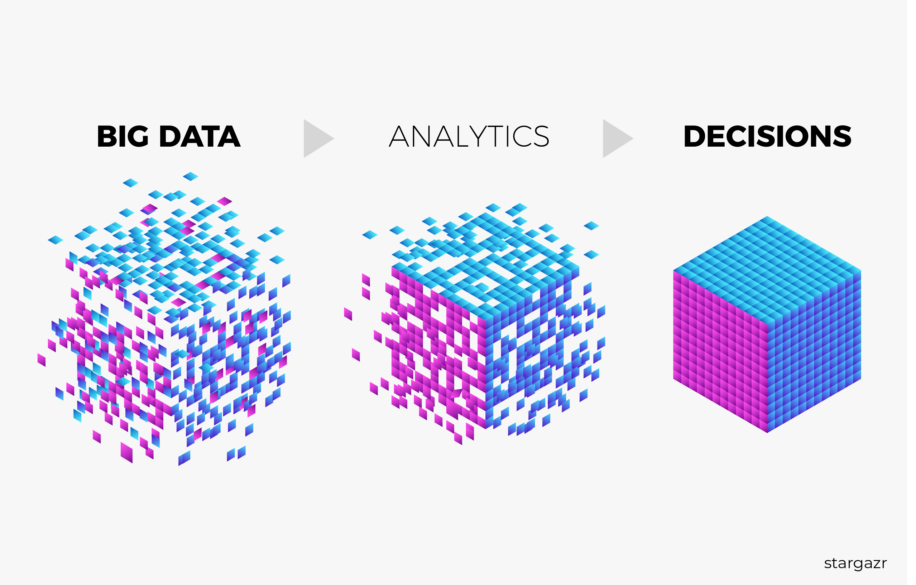
Use of Big Data
Big Data is almost understood as Big Data Analytics

Slide 23

Data analytics has a long history…
Story of “Beer and Diapers” in early 1990’s
Market basket analysis in a supermarket
Analyze what products customers purchase together
Common expected result:
Bread and butter
Something interesting:
Beer and diapers have been purchased together frequently
Nowadays, any data analytics tasks may be referred as Big Data Analytics
Is this a good sign?
Diapers

Slide 24
Big Data Analytics tools
Data cleaning
Improve the data quality of your data
ETL
Extract-transform-load pipeline to preprocess your data for your analysis
Analytics tools
Machine learning / Data mining / Artificial Intelligence

Slide 25
Big Data Analytics pipeline and example
Data from cryptocurrency exchanges, social networks, etc.
Data sources
Normalize data, convert categorical data to numbers, calculating training labels etc.
Data lake
ETL tools
Analysis tools
Python libraries
MongoDB
Data cleaning
Result
Predict whether the price goes up or down

Slide 26
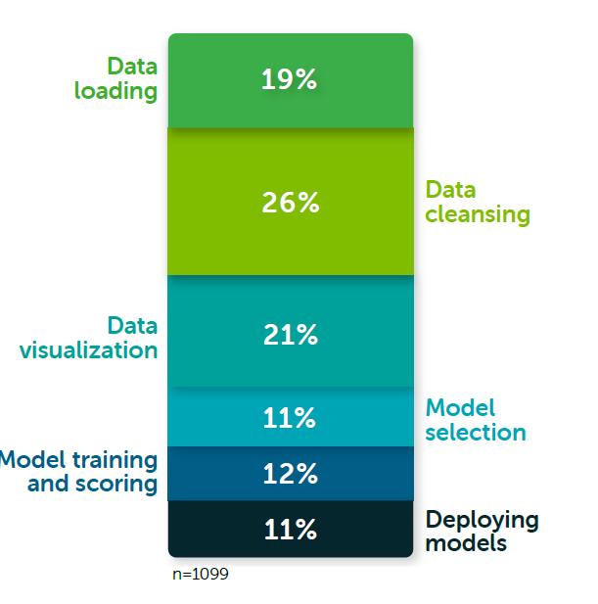
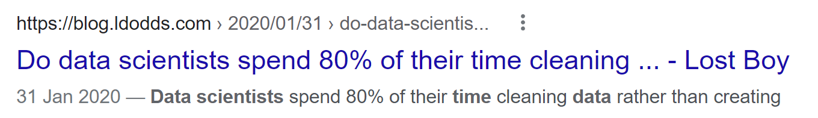
Which part is more important?
Go to google and find the results from similar surveys.

Slide 27
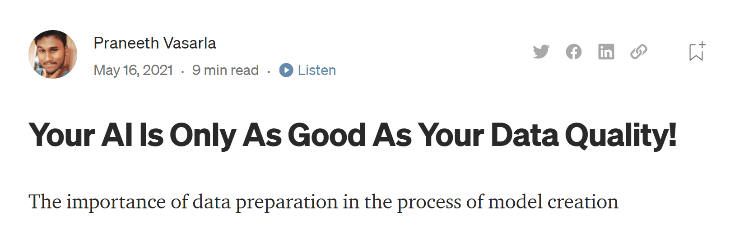
Why is data management important?
https://towardsdatascience.com/your-ai-is-only-as-good-as-your-data-quality-42be9ab533b9

Slide 28
University education vs work
You will learn a lot of theories, maths, and so-called hands-on skills at the University
Most of time you spent at work is not about the above knowledge
NOTE:
Don’t get confused. These are still very important! They make you a real professional
Always remember, a key to success of your data science / AI project is the data

Slide 29
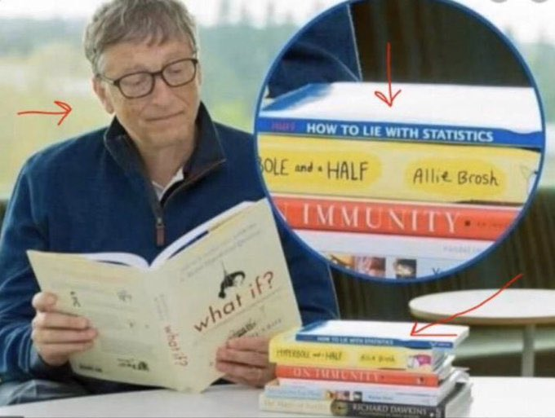
Working with data

Slide 30
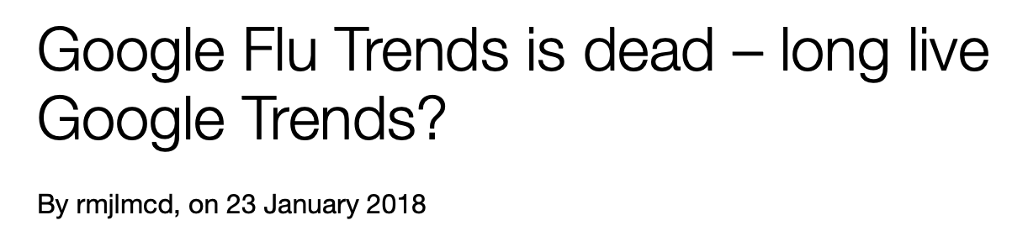
Good luck
Big Data is not always a successful story
The initial Google paper stated that the Google Flu Trends predictions were 97% accurate comparing with CDC data.
In the 2012/2013 season, it predicted twice as many doctors’ visits as the US Centers for Disease Control and Prevention (CDC) eventually recorded

Slide 31
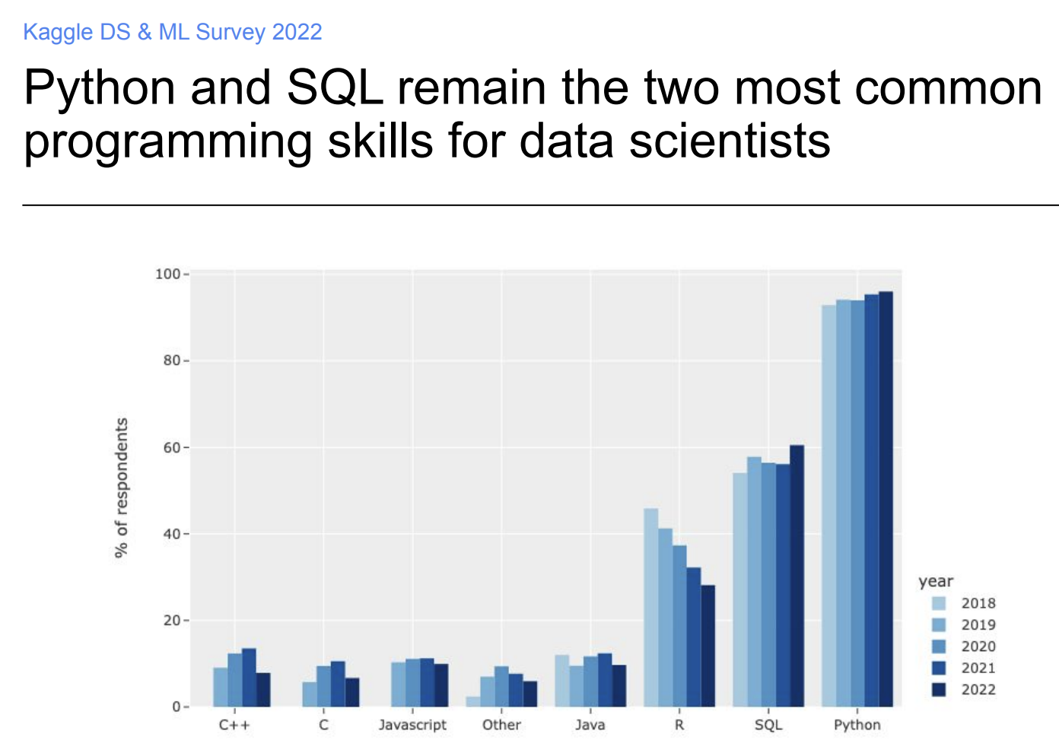
Current trends in data science
Kaggle Report 2022
No data collection exercise in Kaggle Report 2023
Programming language

Slide 32
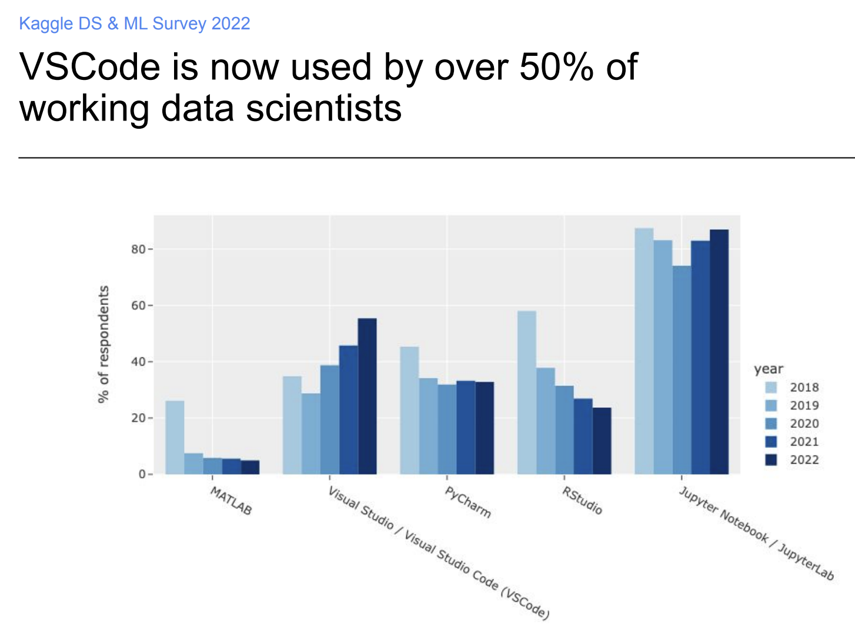
IDE (Integrated Development Environment)

Slide 33
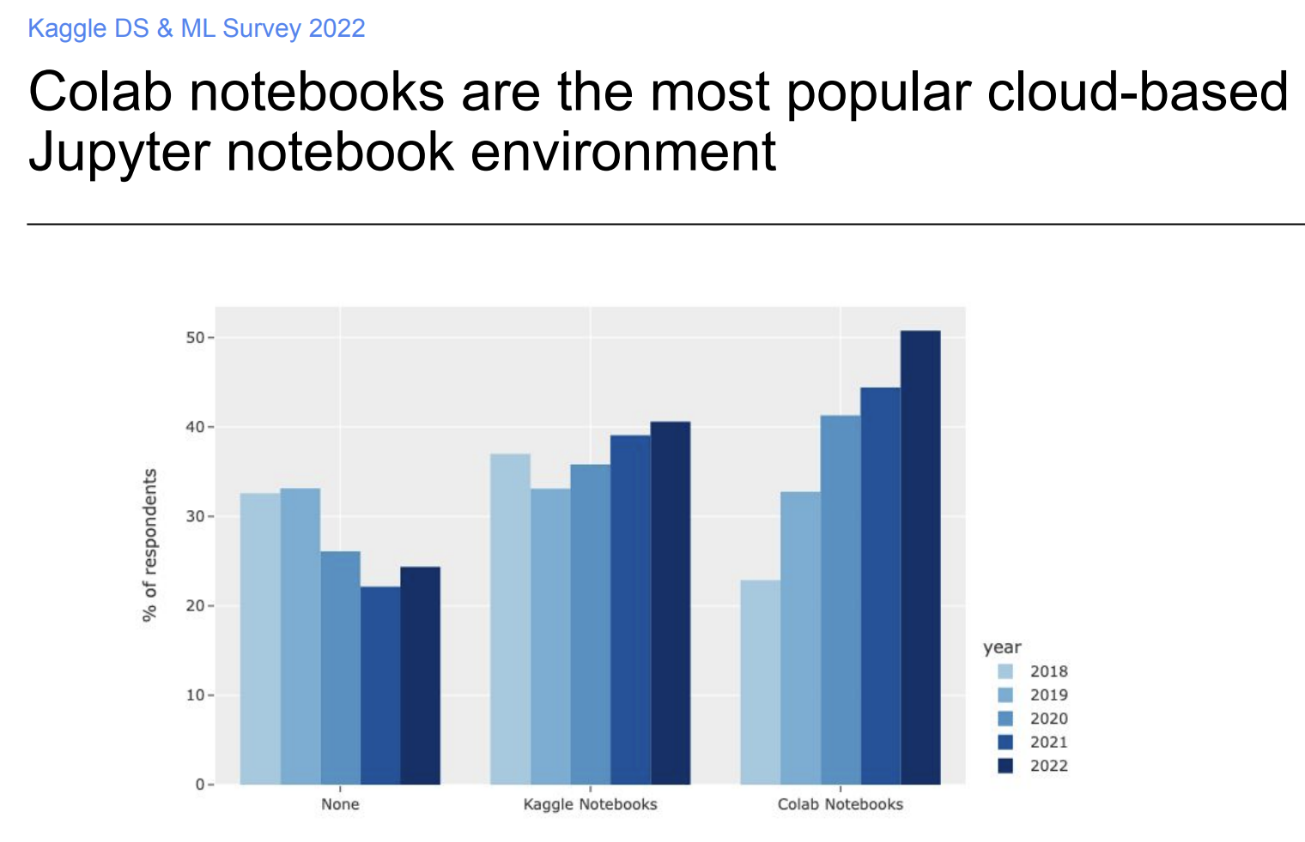
Cloud notebook environment

Slide 34
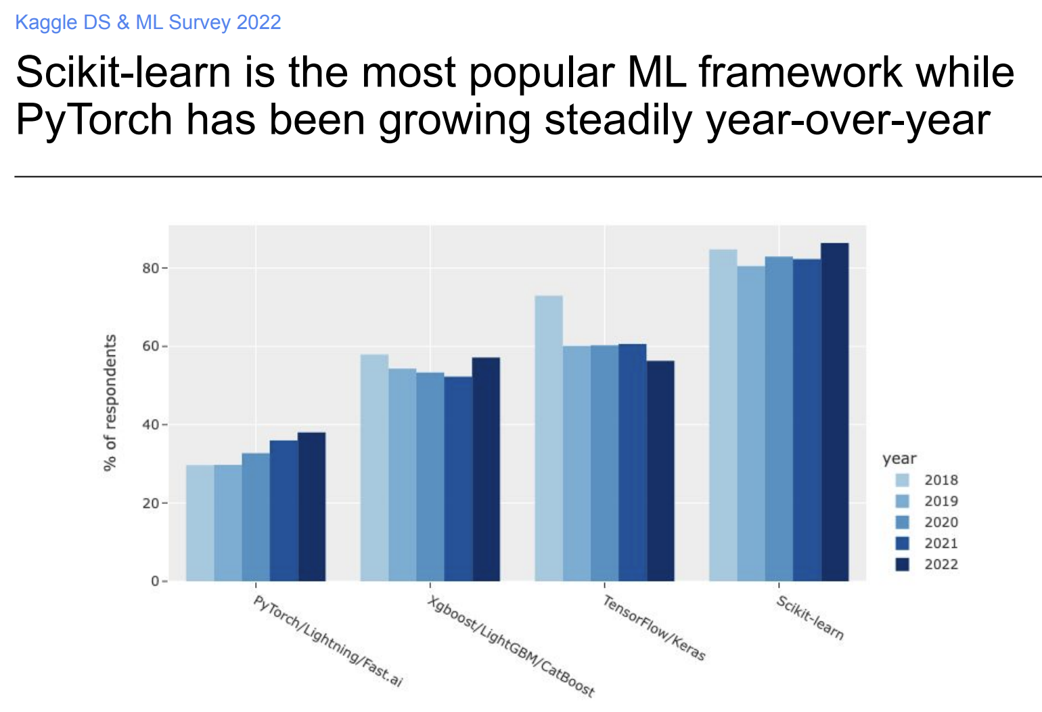
Machine learning framework

Slide 35
Self-study: More results on Kaggle Report
https://www.kaggle.com/kaggle-survey-2022

Slide 36
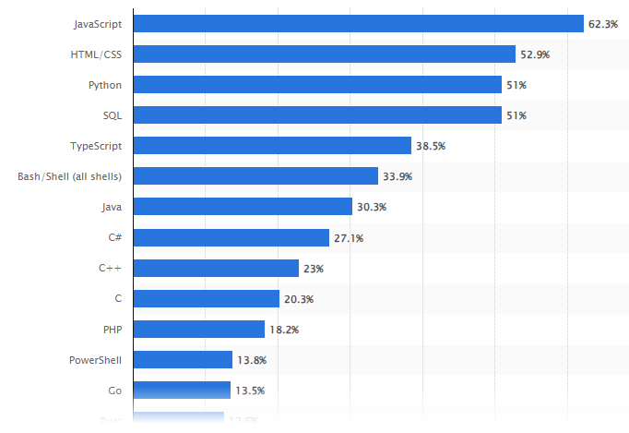
Statistics from other sources (2024)
Programming language
https://www.statista.com/statistics/793628/worldwide-developer-survey-most-used-languages/
Not just for data science / AI

Slide 37
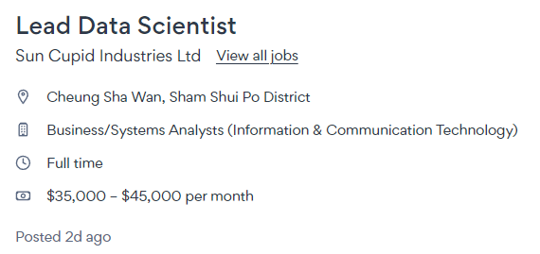
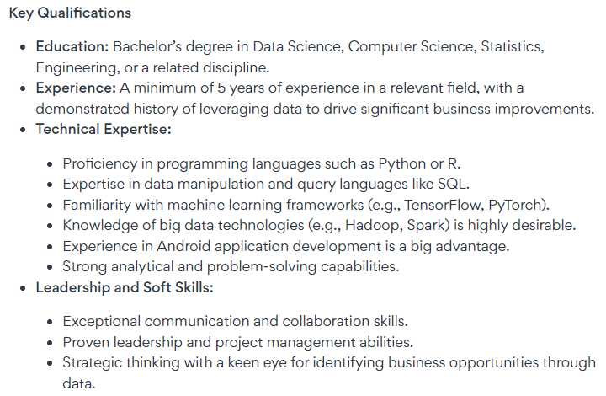
What is your career plan?
Understanding the market needs
Example: Jobs DB
https://hk.jobsdb.com/
Note: I just pick the first 3 jobs that state the salary when I search on 25 Aug 2024 around 3pm. No cherry picking.

Slide 38

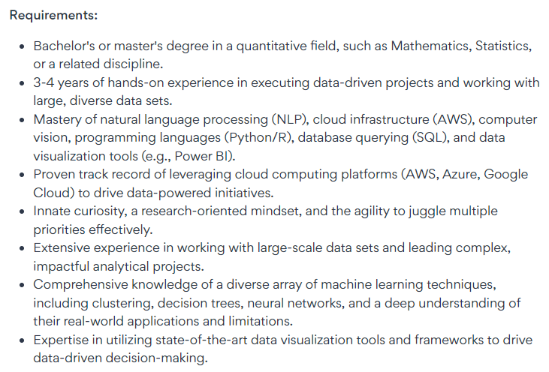

Slide 39
